Slide 1
Job analysis
Job task
Job analysis
Job duties
Job responsibility
Job analysis can be described as th process involving formal and detailed examination of the jobs, which involves the identification of required tasks, knowledge and the skills necessary for performing them and the conditions under which they should be performed.

Slide 2
The three basic parts of Job analysis
1. identifying job
2. obtaining information about the tasks, duties, responsibilities and working condition of the job.
3. Determine the worker characteristics needed for successful performance of the job.
Job analysis can be written as:
Job analysis = job description + job specification + job performance standards

Slide 3
What aspects of a job are analyzed?
Duties and tasks: information to be collected about these items : frequency, duration, effort , skill, complexity, equipment standard.
Environment: work environment include: unpleasant conditions such as offensive odors and temperature extreme and risks for incumbents as noxious fumes, radioactive substance, aggressive people, dangerous explosive.
Tools and equipment: specific equipment for specific job like: protective clothing, any items needed to perform the task.
Relationship: supervision given, relationship with internal external people.
Requirement: these include the knowledge , skills and abilities .

Slide 4
Job analysis information
Job identification: job title, job code number.
Characteristics of the job: job location, physical setting, supervision levels required, hazard associated
Job duties : a detailed list of the duties along with the probable frequency of occurrence.
Equipment's and material used.
How a job is done: nature of operation associated with a job.
Personnel attributes: experience level, training undertaken, physical strength, mental capabilities, social skills, communication skills.
Job relationship: opportunities for advancement.

Slide 5
Components of Job analysis
Job description:
A broad, general, and written statement of a specific job, based on the findings of a job analysis. It generally includes duties, purpose, responsibilities, scope, and working conditions of a job along with the job's title, and the name or designation of the person to whom the employee reports.
Job specification:
A statement of employee characteristics and qualifications required for satisfactory performance of defined duties and tasks comprising a specific job or function. Job specification is derived from job analysis.

Slide 6
Use of job analysis according to HR and Industrial Psychology
Human resource planning
Recruitment
Selection
Induction
Training
Counselling
Performance appraisal
Job design and redesign

Slide 7
When to do ?
When a new job is created
radical transformation due to changes in new technologies, methods, producer or system
Process of job analysis
Organizational analysis: ( relationship between job and organizational objectives)
Selection of representative position to be analyzed: (sample of job need to analyze keeping cost and time constraint)
Collection of job analysis data:(characteristic of a job, required behaviour, personal qualification)
Preparation of job description:(functions,duties,responisibilities,operations)
Preparation of job specification: (traits, skills, training, experiences needed)

Slide 8
Job Description | Job Specification
A statement containing items such as: | A statement of human qualifications necessary to do the job usually contains such items as:
1) Job title | 1 ) Education
2) Location | 2) Experience
3) Job summary | 3) Training
4) Duties | 4) Judgment
5) Machines, tools, and equipment | 5) Initiative
6) Materials and tools used | 6) Physical effort
7) Supervision given or received. | 7) Physical skills
8) Working conditions | 8) Responsibilities
9) Hazards | 9) Communication skills
 | 10) Emotional characteristics
 | 11) Unusual sensory demands such as sight, smell, hearing

Slide 9
Sources of Job Data
Sources of Job Data | Human Sources
Existing job descriptions and specifications Equipment maintenance records Films of employees working Training manuals and other job training materials | Job incumbents Supervisors Job experts

Slide 10
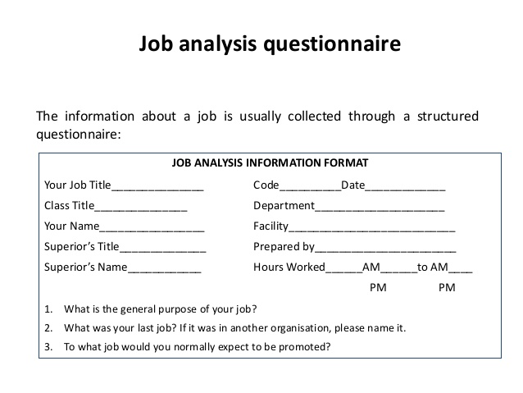

Slide 11
Methods of Data Collection for Job Analysis
Questionnaire:
This method is usually used to obtain information about jobs through a mail survey. This method is, therefore, best suited to clerical workers.
Checklist: This method requires the worker to check the task he performs from a long list of possible task statements. They are easily administered to large groups and are easy to tabulate.
Interview: In this method a group of representative job incumbents are selected for extensive interview - usually outside of the actual job situation. This method though very costly and time consuming helps in getting a complete picture of the job.

Slide 12
Methods of Data Collection for Job Analysis
Observation:
This method can be followed right on the job. The analyst observes the incumbent as he performs his work and questions him to get the required data. Working conditions and hazards can also be better described when observed personally by the analyst.

Slide 13
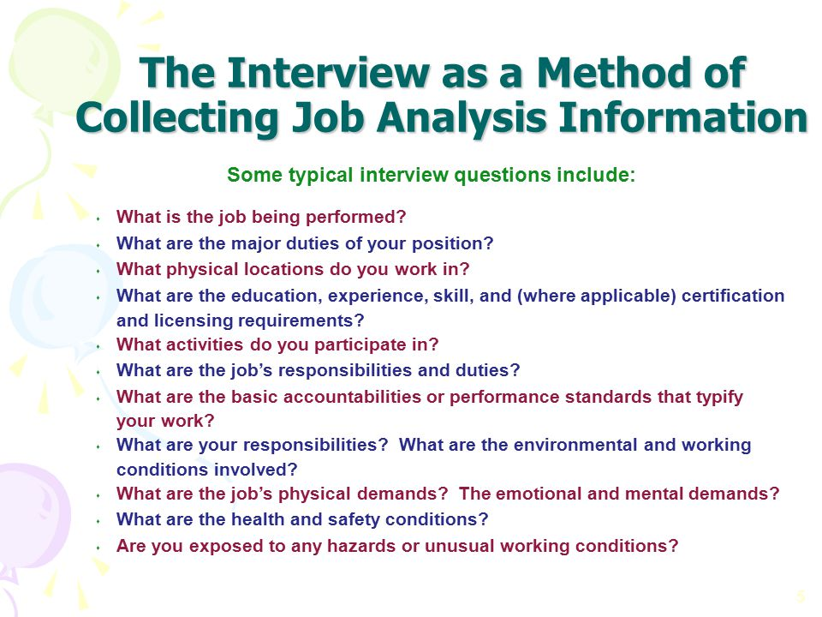

Slide 14
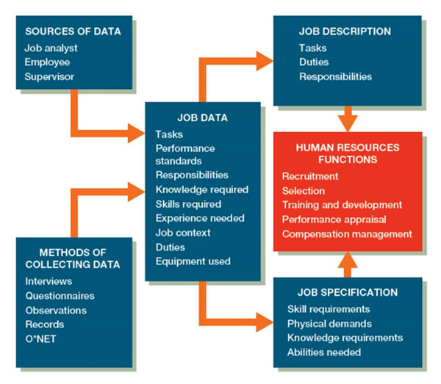

Slide 15
Recruitment
Recruitment is the discovering of potential applicants for actual or anticipated organizational vacancies.
simple terms, recruitment applies to the process of attracting potential employees to the organization or company.

Slide 16
Procedure of Recruitment
This process includes
recruitment planning,
identification of recruitment sources,
contacting those sources,
receiving applications from prospective employees.
Selection

Slide 17
Personnel
Planning
Job
Analysis
Employee
Requisition
Job
Vacancies
Recruitment
Planning
-Numbers
-Types
Searching
Activation
“Selling”
-Message
-Media
Applicant
Pool
Potential Hires
Screening
To Selection
Strategy
Development
-Where
How
- When
Applicant
Population
Evaluation
And
Control
Recruitment planning

Slide 18
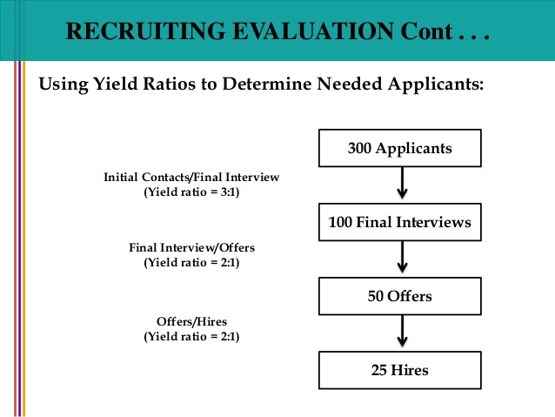

Slide 19
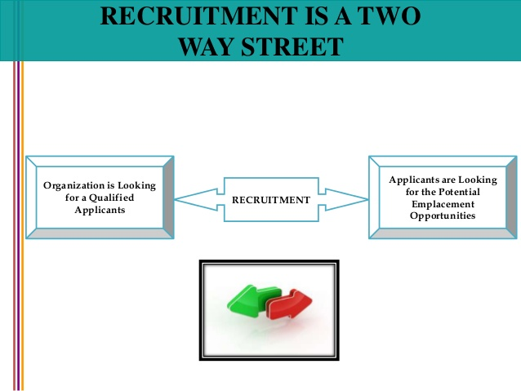

Slide 20
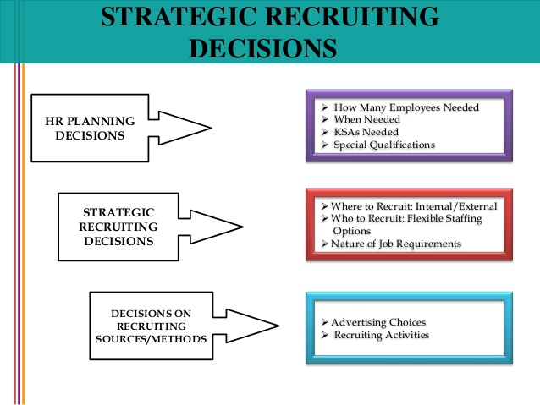

Slide 21
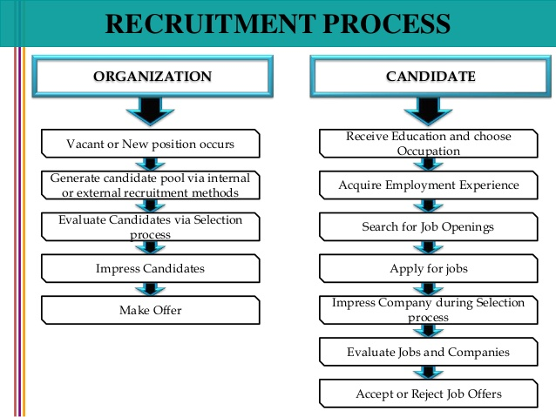

Slide 22
Recruitment waterfall at TCS
Recruitment
Detailed designed and plan
Cultivate source
Integrate selection test interviews
offer
Induct
Integrate information
Train
Deploy

Slide 23
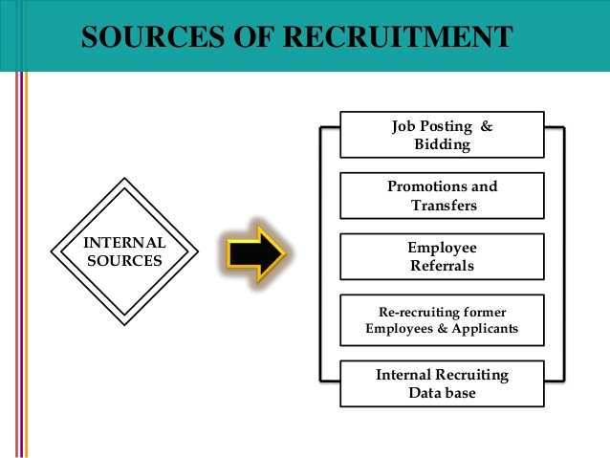

Slide 24
Recruitment
Advertisements
Present Employees
Employment Exchanges
Campus Recruitment
Internal Sources
External Sources
Employee Referrals
Walk-ins and Write-ins
Former Employees
Consultants
Previous Applicants
Contractors
Competitors
E-Recruiting
Sources of Recruitment

Slide 25
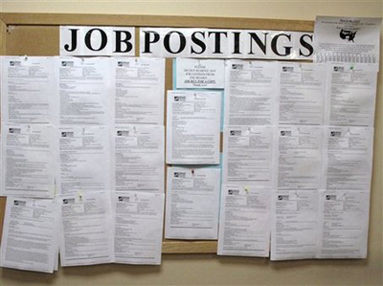
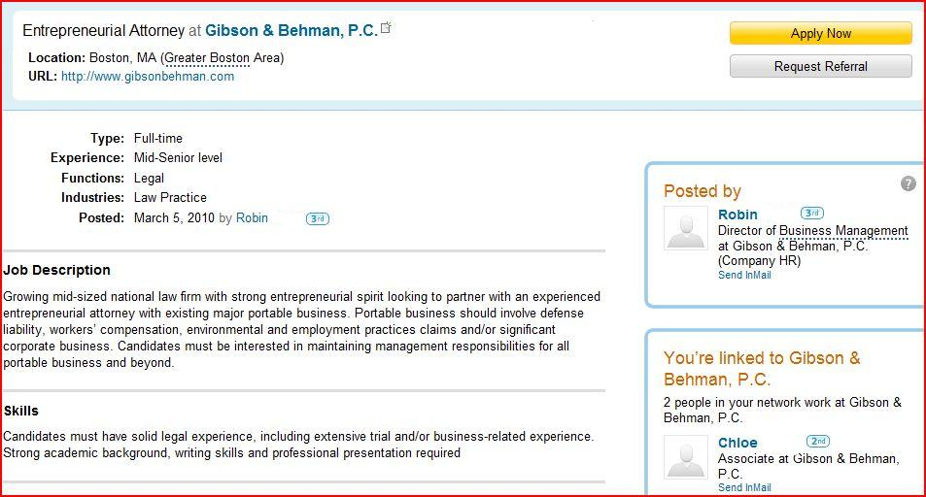
Internal sources
Job Posting: Job posting is another way of hiring people from within. In this method, the organization publicizes job openings on bulletin boards, electronic media and similar outlets.

Slide 26
